Slide 1
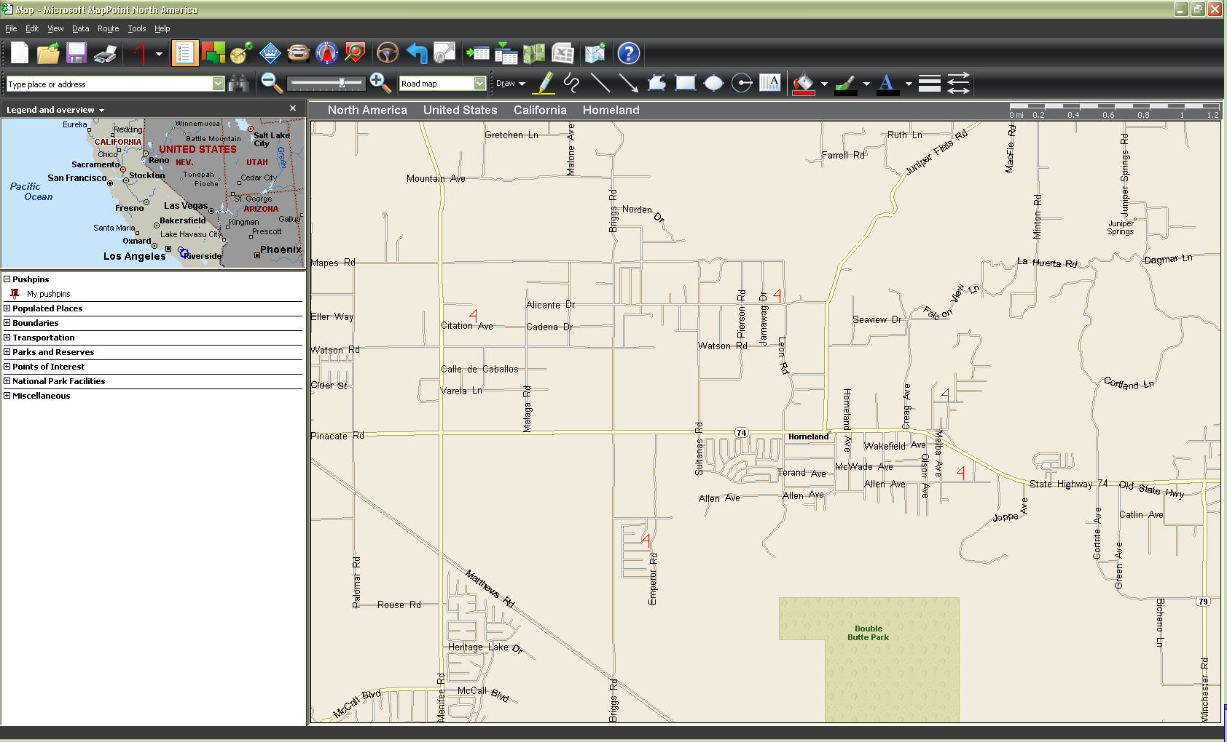
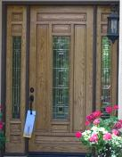

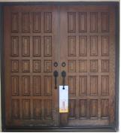


Sub Map #1:
6.5 Square Miles; 5060 Households; 2051 Targets; Penetration % = 41%
Team speed = 3.5 MPH; Ground covered = 57 Miles
2
3
5
1
4
1
2
3
4
5
27972 Paseo Del Norte
21 Ave. of the Stars
57 Orchard
453 MLK Blvd.
12565 Allen Rd.
92675
92675
92675
92675
92675

